Slide 1
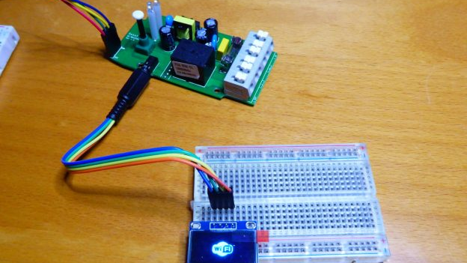
Smart-sensor revolution
A sensor that will be able to tell the humidity, temperature and time at any given location.
Coded by Evans Nchebere and Malik Madani
This Photo by Unknown Author is licensed under CC BY-SA

